Slide 1


Slide 2
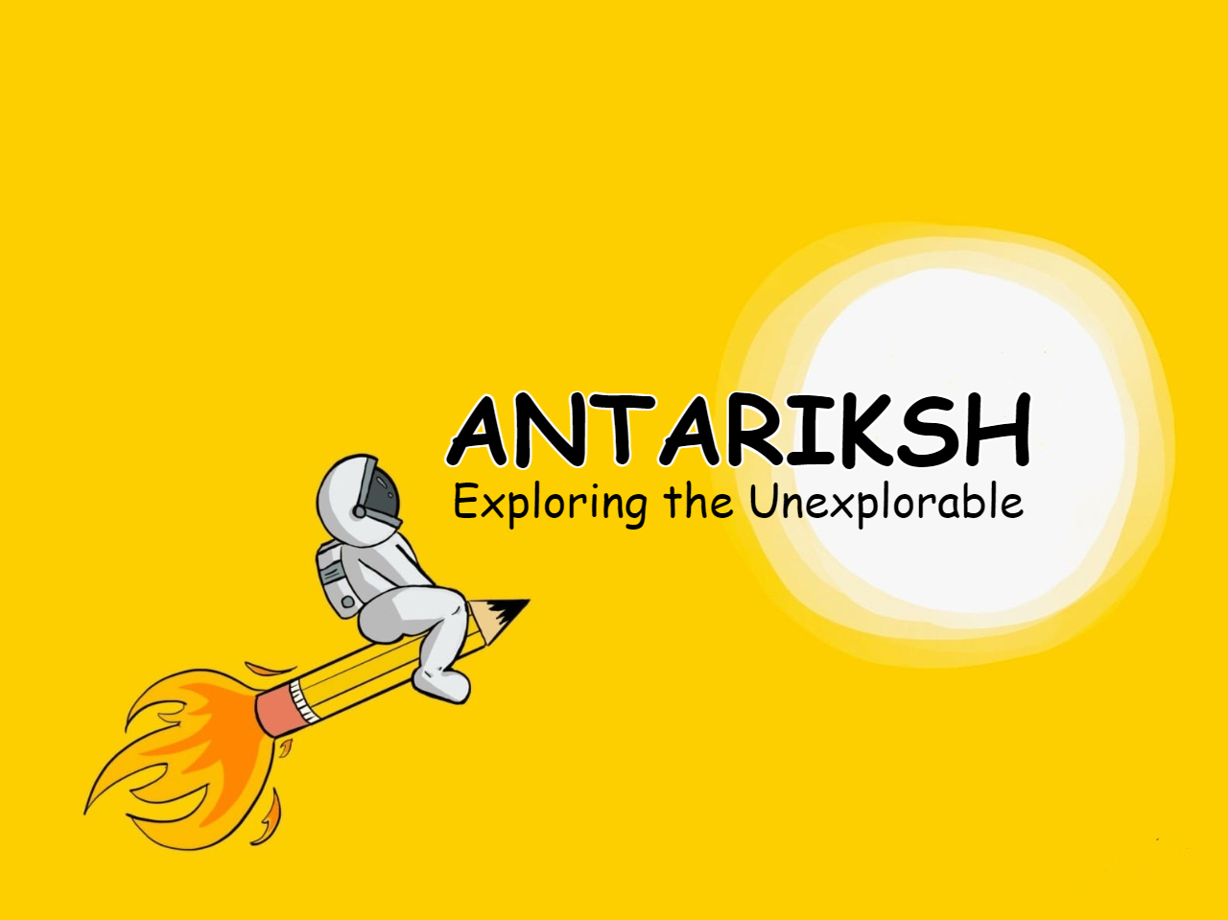

Slide 3
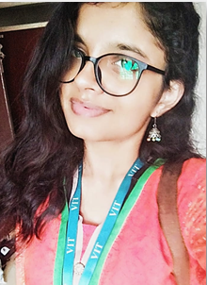
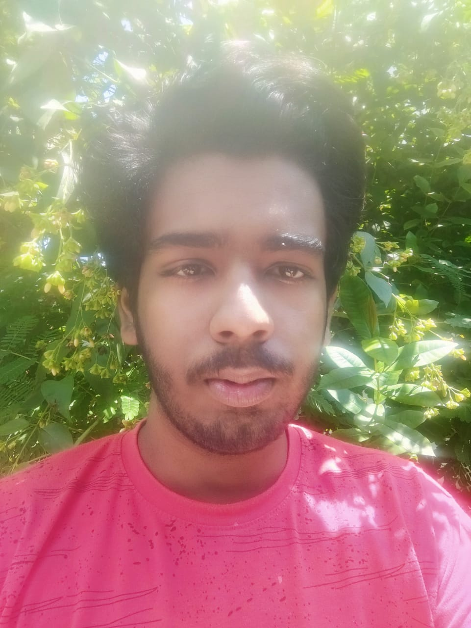
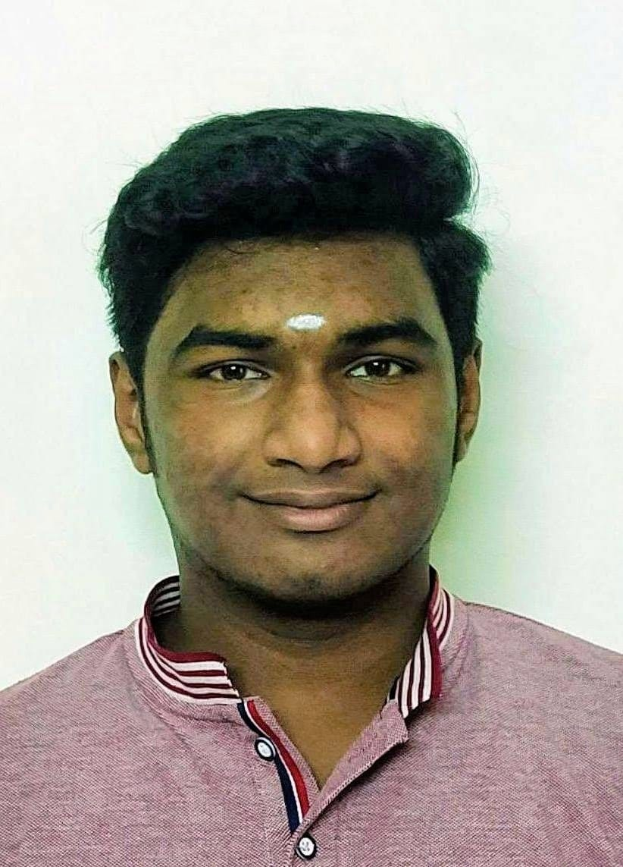
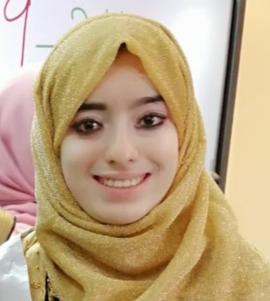
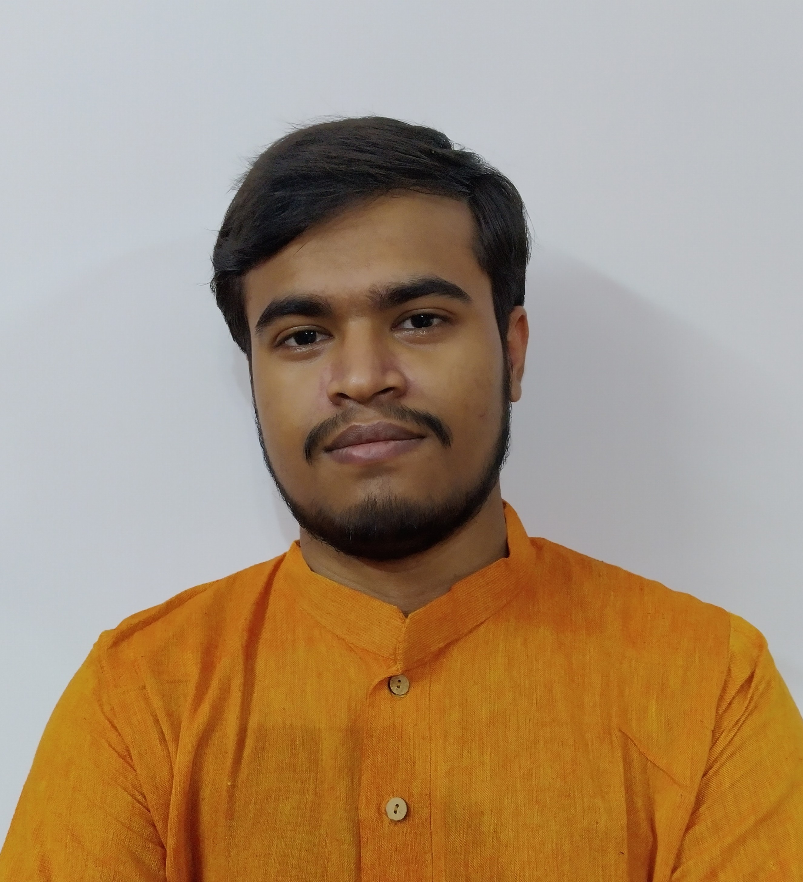
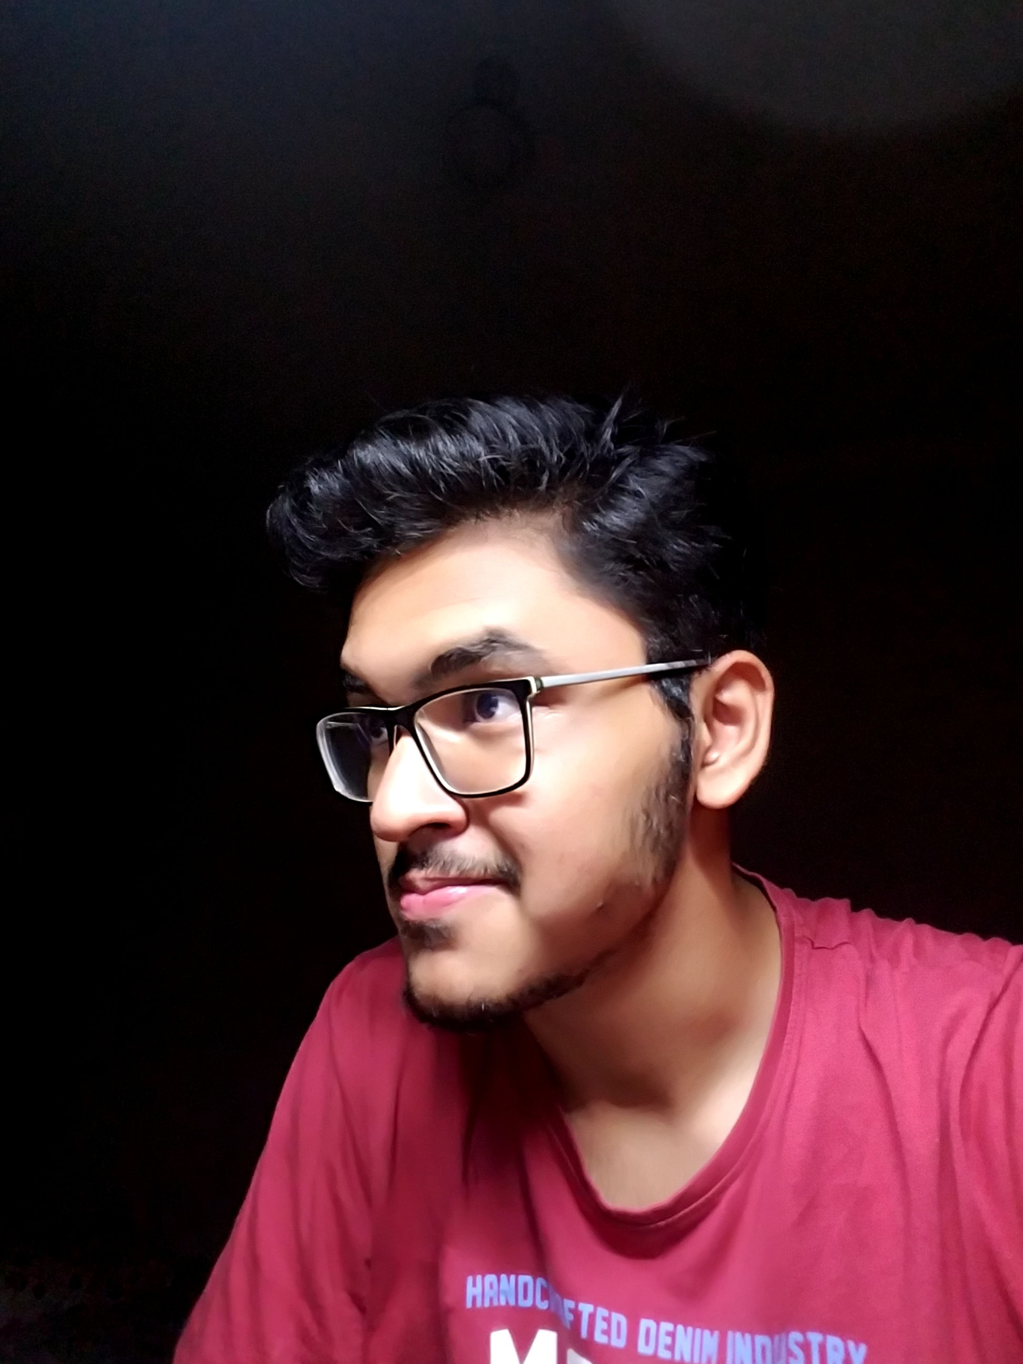
About us
Team name: ANTARIKSH
Challenge selected: UNLOCKING THE SECRETS OF THE SUN
Venue:
AARUUSH, CHENNAI
SAMBHAVI RAI
2022-VIT CHENNAI
RAAGULBHARATWAJ K.
2021-VIT CHENNAI
KAUSHIK RAJA
2023-VIT CHENNAI
ASHNA HUSSAIN
2024-VIT CHENNAI
AYUSHMAN DASH
2024-VIT CHENNAI
MANGOLIK KUNDU
2023-VIT CHENNAI

Slide 4
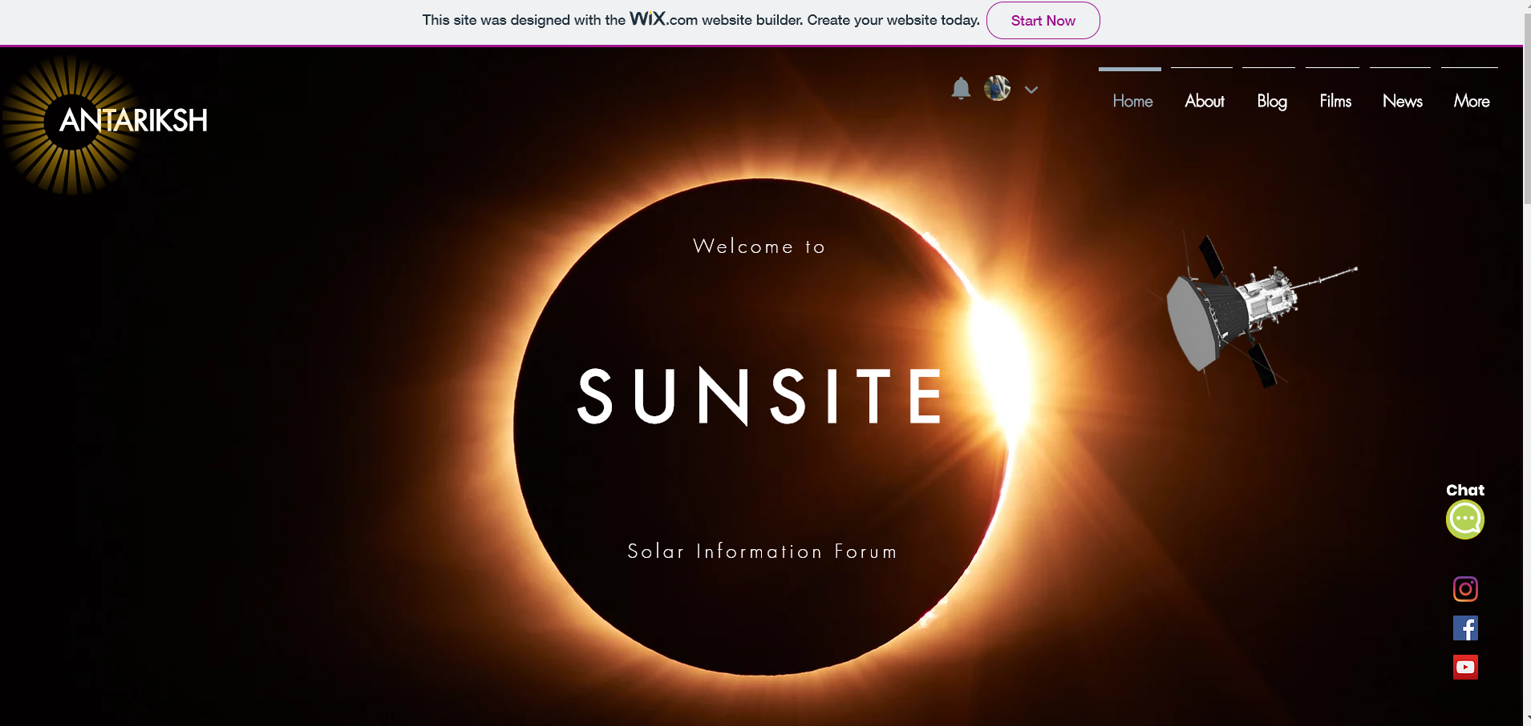
SOLUTION
PROBLEM
Sun is the closest star to the Earth but still humanity is not able to understand how important is the solar mission and how the data collected impacts our lives on Earth. Design an interactive and immersive tool to improve public knowledge of the many spacecraft exploring the Sun – including Parker Solar Probe. To design a tool or method should help the public understand how the valuable data these missions provide impacts the way we live, work, and play.
The solution should encourage the tool users to think about the future of solar exploration; e.g., "What would a future mission look like and what aspects of the Sun would it explore?"
Team Antariksh plans to make a website called SUNSITE which acts as an information forum for the Sun.
Key features of SUNSITE:
Articles and blogs related to latest solar discoveries and how it affects our daily lives.
Short animated stories.
Dedicated kid’s corner.
A detailed study of Parker Solar Probe.
An ML model to forecast solar weather
.
Home page of SUNSITE

Slide 5











SUNSITE
FEATURES
Notes:
https://unsplash.com/photos/AXu2aZ3YgP8

Slide 6

BLOGS

Slide 7
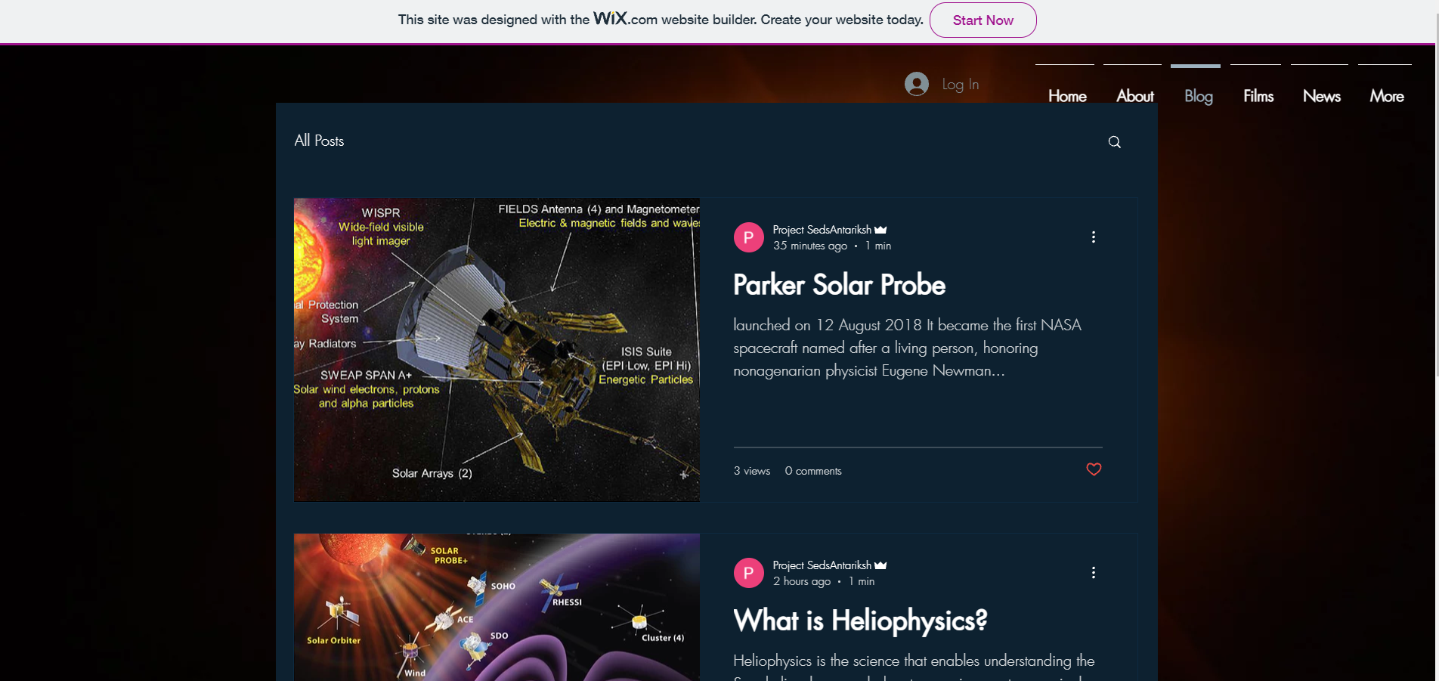
BLOGS
SUNSITE has a number of blogs on
variety of topics such as space weather, solar wind, heliophysics etc. which will increase the user engagement.
Notes:
https://unsplash.com/photos/fItRJ7AHak8

Slide 8

NEWS

Slide 9
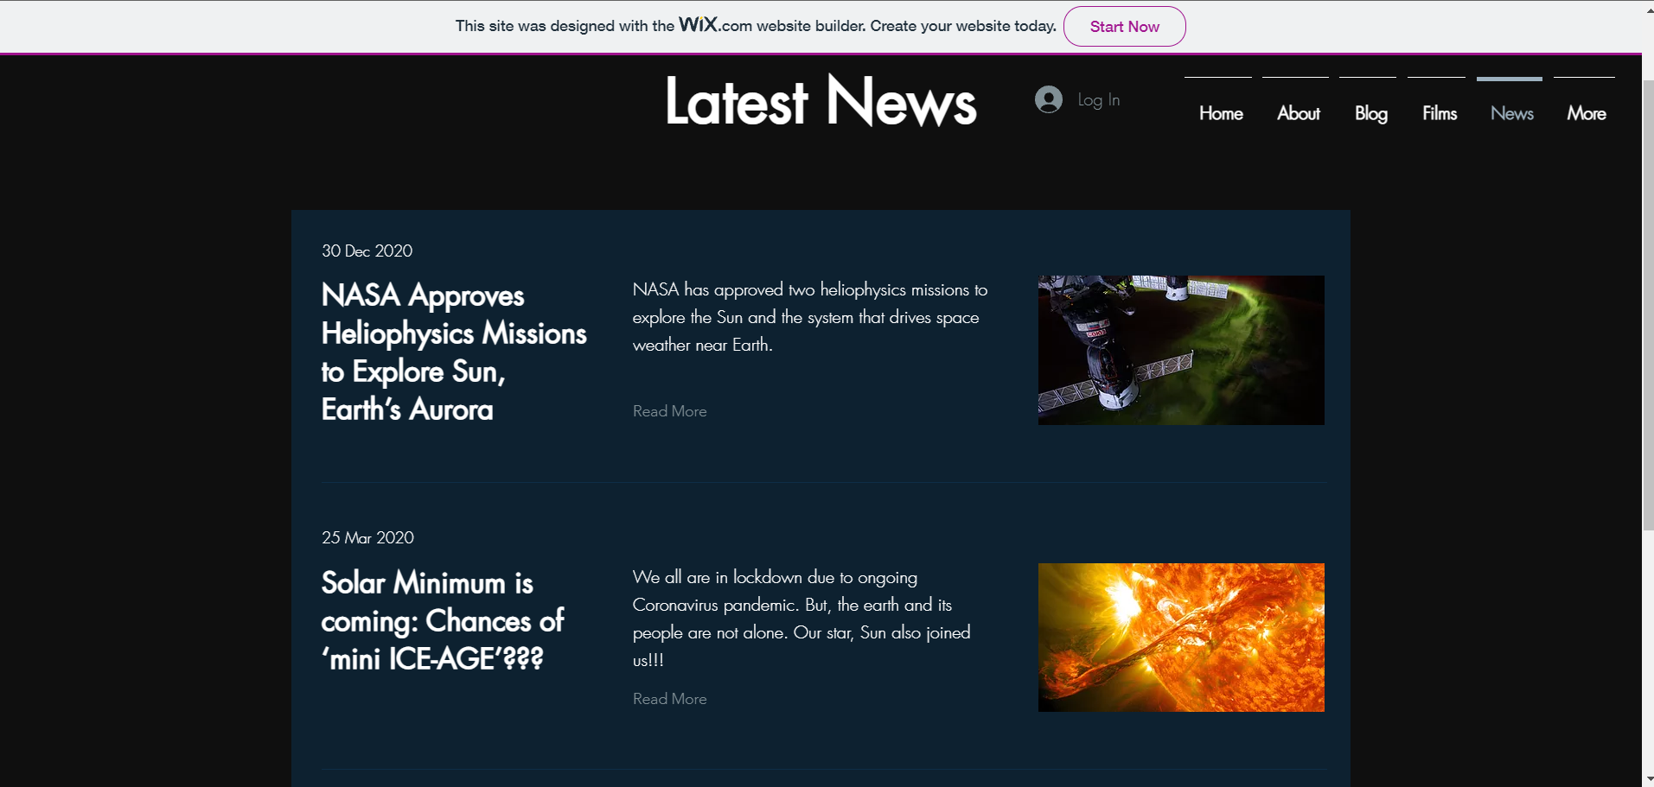
NEWS
SUNSITE includes a news page where all the relevant space news will be updated.
The News page is designed to keep the masses up to date with recent solar discoveries and launch solar probes.
Notes:
https://unsplash.com/photos/48nerZQCHgo

Slide 10

SPACE
STORIES

Slide 11
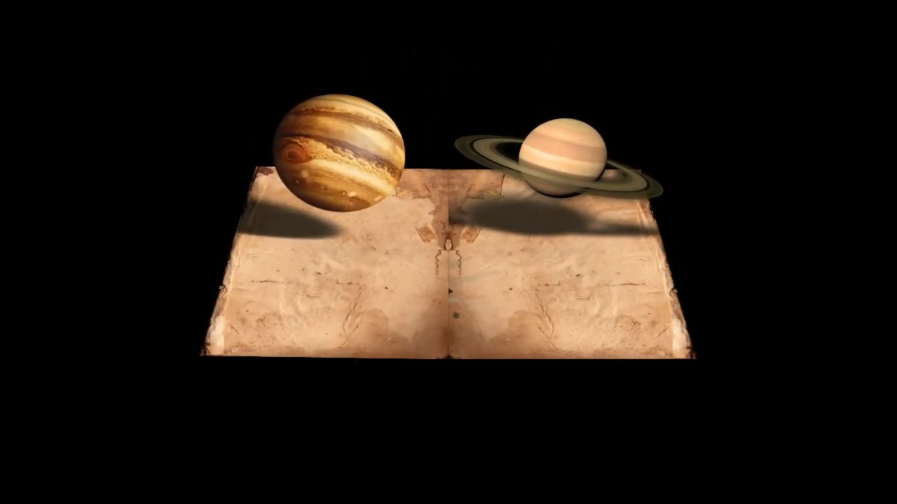
SPACE
STORIES
SUNSITE is equipped with a series of space stories aided with animation, graphics and other visual tools. This is an approach to increase awareness by effective use of visuals.
Notes:
https://unsplash.com/photos/TvN54bnuQg8

Slide 12

PARKER SOLAR PROBE

Slide 13
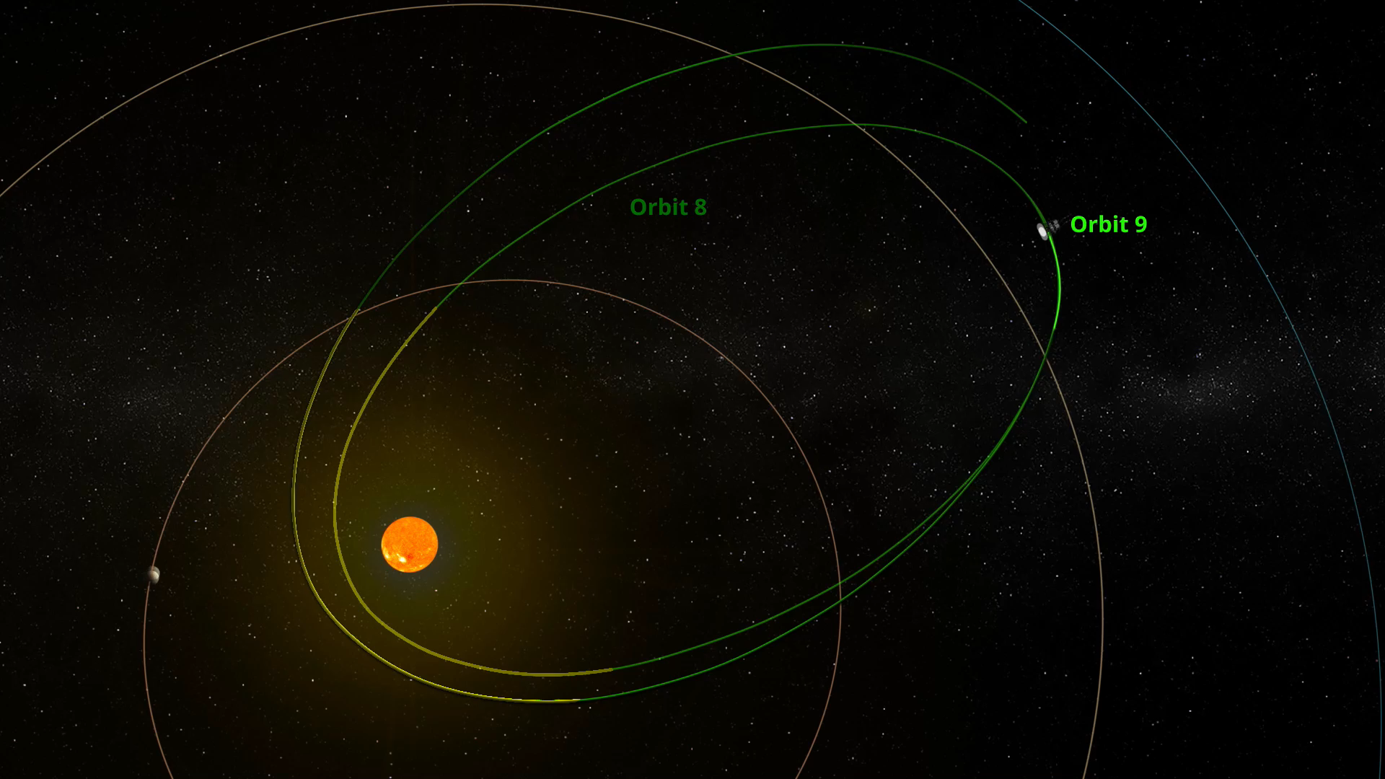
PARKER SOLAR
PROBE
SUNSITE has a collection of simulation videos and blogs of the Parker Solar Probe launched by NASA. This is an approach to increase awareness and understanding of this ingenious spacecraft and how its data is useful to us.
Notes:
https://unsplash.com/photos/GKLIsLZxhj0

Slide 14

ASAP
Autonomous
Solar Activity Predictor

Slide 15
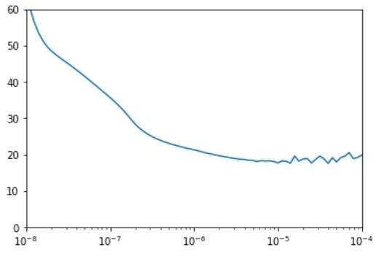
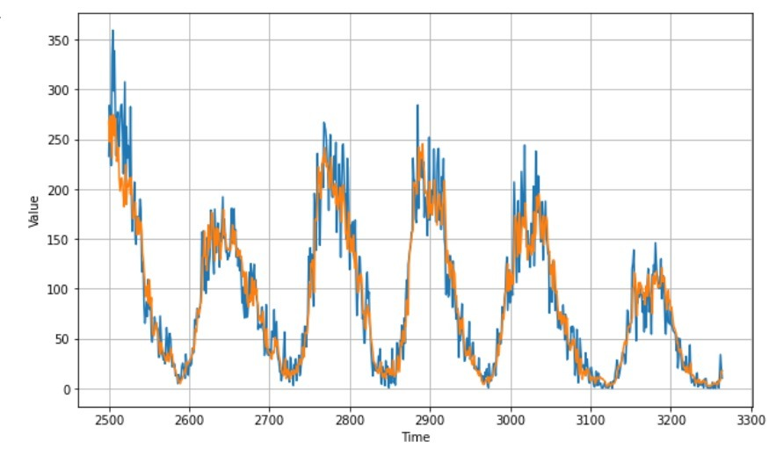
MACHINE LEARNING
SUNSPOT WEATHER
PREDICTION
We have made an ML model called ASAP(Autonomous Solar Activity Predictor). That will forecast the solar weather accurately.
Notes:
https://unsplash.com/photos/GKLIsLZxhj0

Slide 16

DISCUSSION FORUM

Slide 17
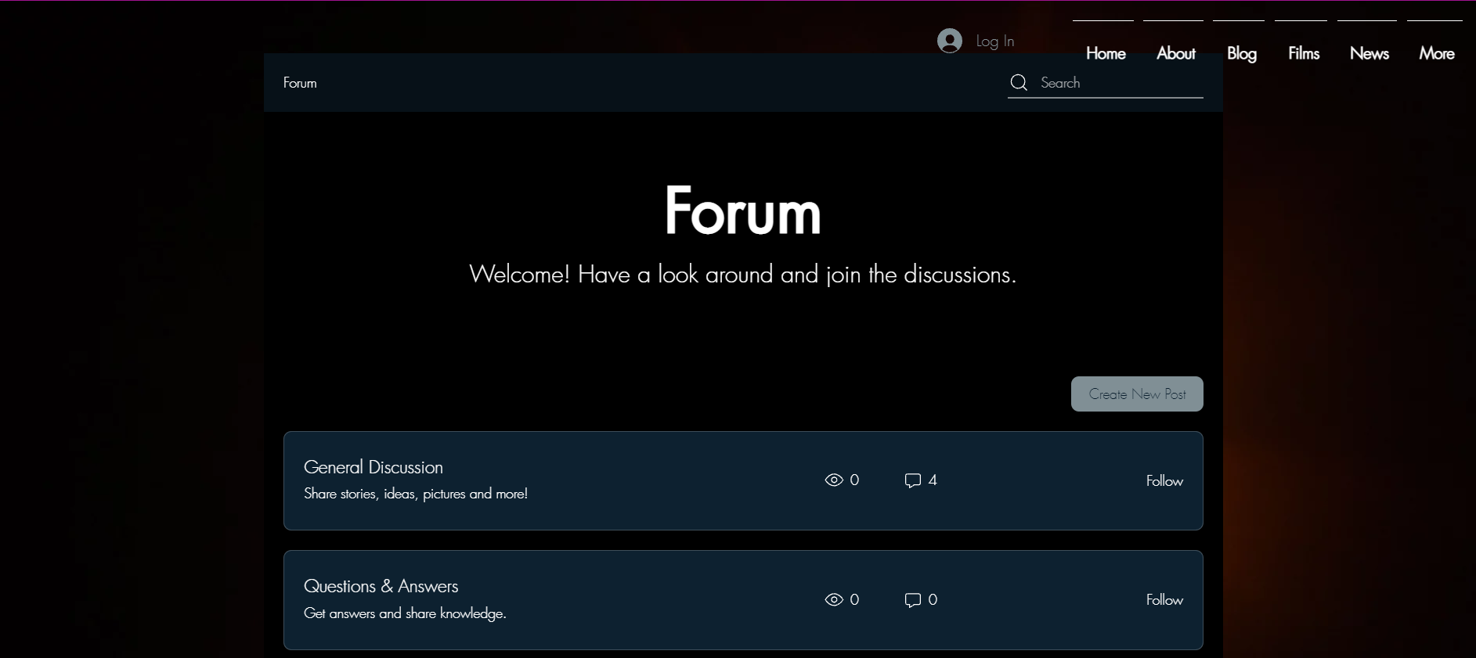
DISCUSSION
FORUM
We at SUNSITE have a discussion forum where people can interact on space related topics and thereby increase social awareness on hidden aspects of space exploration.
Notes:
https://unsplash.com/photos/GKLIsLZxhj0

Slide 18

The Future
SUNSITE:
The only dedicated site for Sun
We strongly feel our sunsite will have a great impact on future and the following are the features we will be adding on
Issue regular newsletters to subscribers based on new solar discoveries.
Adding engineering strip downs of more solar orbiters.
We have planned to deploy the solar weather predicting ML model in our website.
Develop an Android app for the same
Application of the ML model in future space missions.
We will be adding a new animated story weekly to keep our audience engaged in learning.
Collaborations with Outreach teams of various space related student chapters for educating rural masses on sun.

Slide 19
Days of Hackathon
The topic, “UNLOCKING THE SECRET OF THE SUN” awoke childlike curiosity among us and through our project, “SUNSITE”, we aim to impart the same curiosity in every human being.
It was particularly fun to go through the sites of NASA, ESA, JAXA and other space agency in search of open data.
The scope of exploration really intrigued us.
The things that we have learned in the process of this hackathon will surely play a pivotal role in shaping our future.
Hackathon days were really stressful but very enjoyable at the same time.

Slide 20

THANK YOU

